Slide 1


Stationary shop management
Name: mohit Mukesh patel
Division: b
Roll no.: 57
SRN Id: 202200749

Slide 2

Introduction
This C programming project introduces a versatile inventory and shopping cart management system for a fictional stationary store, aptly named 'Stationary Shopee.' The system utilizes linked lists to organize and manipulate inventory items and customer shopping carts. The program provides a user-friendly interface with a menu-driven system that allows users to display the inventory, add items to both the inventory and cart, remove items from the cart, and complete a checkout process. The code emphasizes modularity and efficiency, ensuring seamless interactions between the user, the inventory, and the shopping cart. Overall, this project serves as a comprehensive example of data structure implementation in C for a practical and interactive application.

Slide 3

Who will use my invention
This project benefits both the store administrators and customers. For administrators, it offers a robust tool for efficiently managing inventory, enabling them to add, update, and remove items seamlessly. The system provides real-time insights into stock levels and facilitates inventory tracking, aiding in decision-making processes such as restocking. Additionally, the project automates the checkout process, saving time and reducing the likelihood of errors in bill generation.
On the customer side, the project enhances the shopping experience by offering a user-friendly interface for browsing inventory, adding items to the cart, and checking out seamlessly. The ability to view a detailed bill before finalizing the purchase provides transparency, and the system's responsiveness ensures a smooth and enjoyable shopping process. Overall, the project bridges the gap between store management and customers, creating an efficient and user-centric environment for stationary shopping.

Slide 4
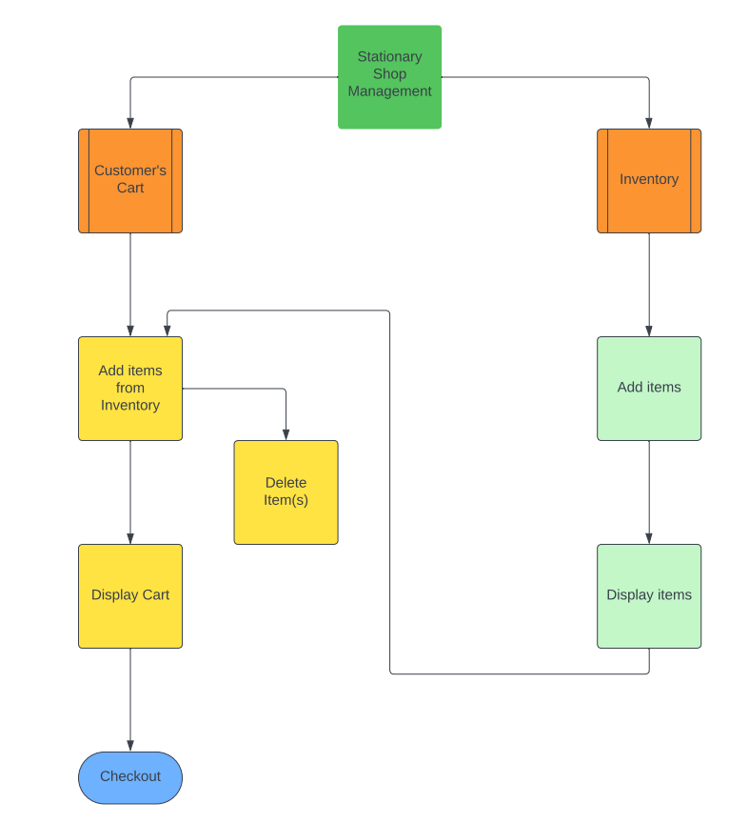
FLOWCHART

Slide 5
Functions used
Inventory Functions
addItem(): Adds a new item to the inventory or creates a new list if the inventory is empty.
removeItem(): Removes an item from the inventory based on its name.
updateItem(): Updates the quantity and price of an existing item in the inventory.
displayInventory(): Displays the contents of the inventory, including item details, quantity, unit price, and total price.
restock(): Increases the quantity of a specific item in the inventory by 50 units.
User's Cart Functions
addItemToCart(): Adds an item to the shopping cart, updating the inventory quantity accordingly.
removeFromCart(): Removes a specified quantity of an item from the shopping cart, updating the inventory accordingly.
displayCart(): Displays the contents of the shopping cart, including item details, quantity, unit price, and total price.
generateBill(): Generates and displays a bill for the items in the shopping cart, including item details, quantity, unit price, and total cost.
Checkout(): Generates a final bill for the items in the shopping cart, displays it, and frees memory used by the cart.

Slide 6
Implementation & output
The implemented C code utilizes LINKED LIST as the primary data structure for both the inventory and the user's shopping cart. Linked lists offer dynamic memory allocation, efficient insertion and deletion operations, and adaptability to changing sizes. The struct InventoryItem and struct CartItem define items in the inventory and cart, respectively, organized through linked lists. This design choice prioritizes flexibility in handling diverse inventory quantities and dynamic cart contents.
WHY LINKED LIST?
It allow for dynamic memory allocation, enabling the system to handle varying numbers of inventory items and cart entries efficiently.
It excel at insertions and deletions, critical operations in managing an inventory and a shopping cart.
Unlike arrays, linked lists don't require pre-allocation of memory, making them suitable for scenarios where the size of the data structure is not known in advance.

Slide 7
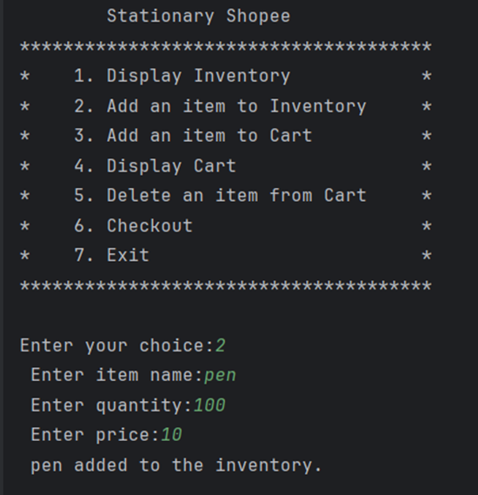
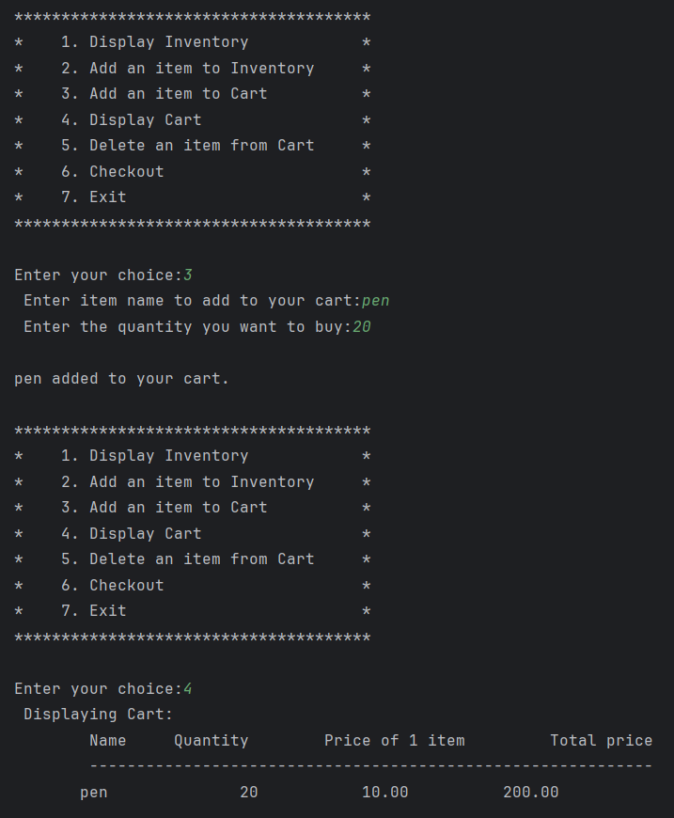
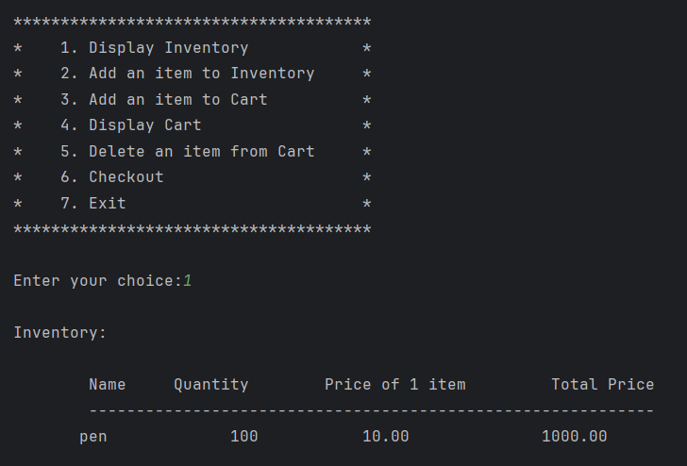
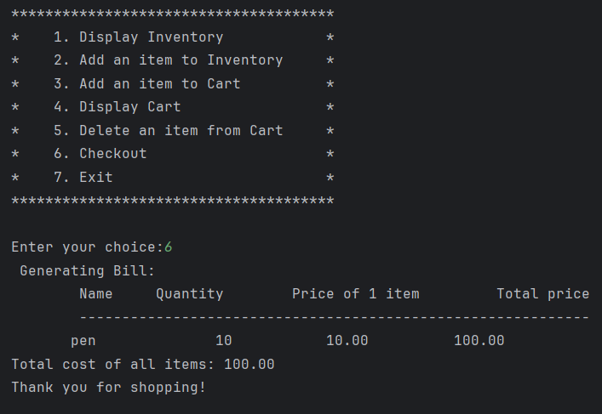
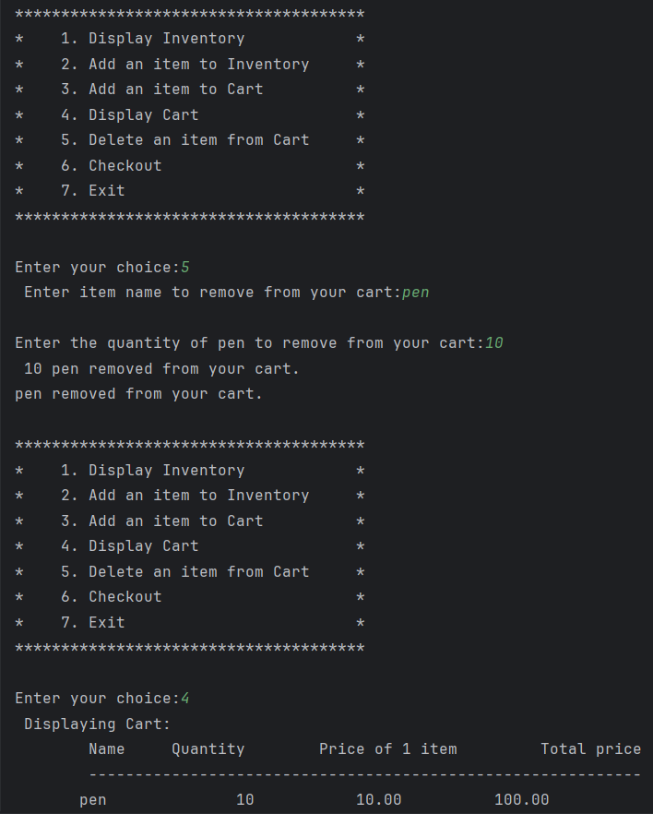

Slide 8
Future scope
Integrate a database system to persistently store inventory and user data, allowing for data retrieval between program sessions.
Integrate barcode or QR code scanning capabilities for efficient item identification and inventory management.
Integrate payment gateways to enable online transactions, enhancing the system for e-commerce functionality.

Slide 9
THANK YOU!

